Slide 1
Recursion Post-order Traversal using Recursion
- Akshay Dhillon

Slide 2
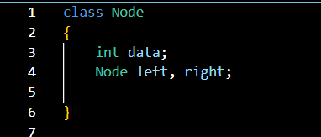
Recursion - Post Order Traversal
Lets assume we have a Binary Tree:
In-order traversal:
When we visit the nodes in the following orders:
Left Node
Right Node
Root Node
In-order Traversal of this given tree would be
4 -> 5 -> 2 -> 6 -> 7 -> 3 -> 1
1
2
3
4
5
6
7

Slide 3
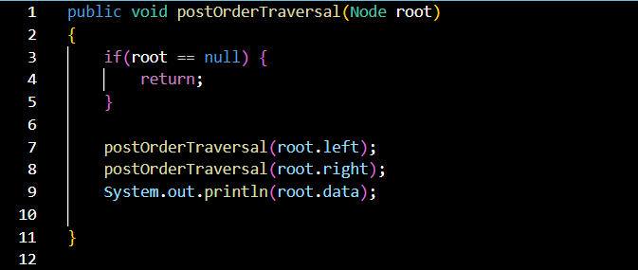
Recursion - Post Order Traversal
Post-order Traversal of this given tree would be
4 -> 5 -> 2 -> 6 -> 7 -> 3 -> 1
Lets assume we have a Binary Tree:
1
2
3
4
5
6
7

